Slide 1
React
Introduction + JSX + Routes
Mahhek Tahir
Notes:
.

Slide 2
What is REACT
A JavaScript library for building user interfaces
Developed and maintained by Facebook (Meta)
Component-based and declarative
Used for building Single Page Applications (SPAs)

Slide 3
Why use REACT?
Component-based architecture (reusable UI elements)
Virtual DOM for efficient updates
Fast rendering
Strong community support

Slide 4
Setting up REACT
Install Node.js
Create a new React app:
npx create-react-app my-app
cd my-app
npm start
Opens in the browser at localhost:3000 or http://192.168.18.7:3000

Slide 5
JSX
JSX (JavaScript XML) is a syntax extension of JavaScript
Allows writing HTML-like code inside JavaScript
const element = <h1>Hello, World!</h1>;

Slide 6
JSX Rules
Must return a single parent element
Use camelCase for attributes (e.g., className instead of class)
Must close all tags (e.g., <br /> instead of <br>)
Embed JavaScript with {} (e.g., {2 + 2} → 4)

Slide 7
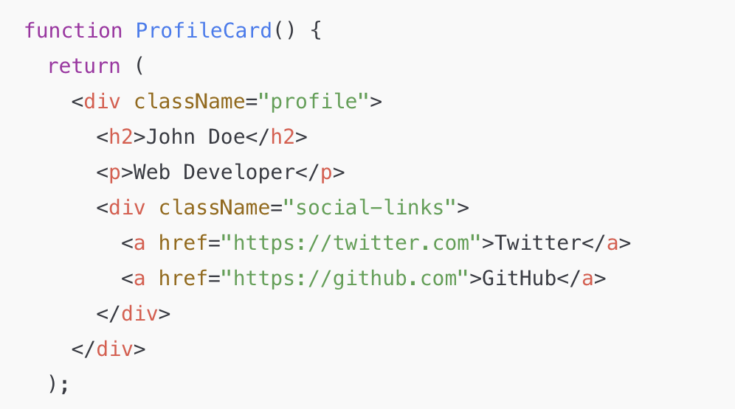
Nested JSX
Multiple JSX elements inside <div>
Can nest components inside each other. If it takes more than one line then use ()

Slide 8
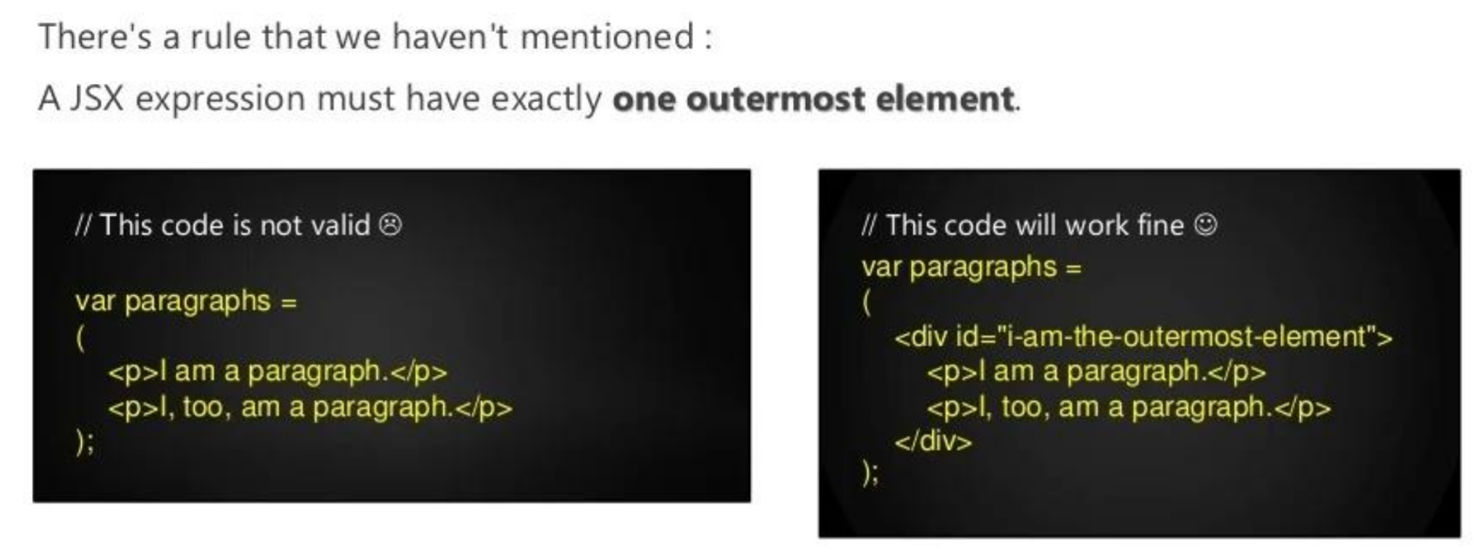
Nested JSX
Data in the format of JSON can be sent by React.js to Express.js, where the process data stores directly in MongoDB for later retrieval.

Slide 9
REACT Components
A component is a small, chunk of code that is responsible for ONE job. The job is often to render some HTML
Function Components
function Greeting() {
return <h1>Hello, World!</h1>;
}
Class Components (older)
class Greeting extends React.Component {
render() {
return <h1>Hello, World!</h1>;
}
}
Function components have largely replaced class components in modern React development.

Slide 10
REACT Event Handling
function ButtonComponent() {
function handleClick() {
alert("Button clicked!");
}
return <button onClick={handleClick}>Click Me</button>;
}
Events are camelCased → Instead of onclick, use onClick.
Use function references, not strings → Instead of onclick="myFunction()", use onClick={myFunction}.
event.preventDefault() is needed → In React, you must call event.preventDefault() manually for form submissions or link clicks.
Notes:
Example: Single java jar file

Slide 11
REACT Form Submission
function FormComponent() {
function handleSubmit(event) {
event.preventDefault();
alert("Form submitted!");
}
return (
<form onSubmit={handleSubmit}>
<button type="submit">Submit</button>
</form>
);
}
Notes:
Example: Single java jar file

Slide 12
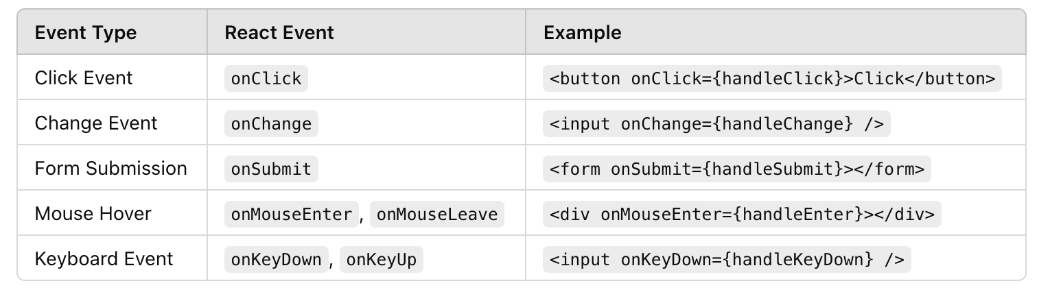
Events
Notes:
Example: Single java jar file

Slide 13
REACT Router
React Router makes your React app work like a multi-page website while staying fast & interactive!
IMPORTANT: npm install react-router-dom
Think of a website. It has different pages:
Home → /
About → /about
Contact → /contact
When you click on a link, the page changes without reloading.
React Router helps React apps do this!
Notes:
Can you use API with monolith?

Slide 14
Benefits
By default, React is just one page (a Single Page Application - SPA). Without React Router, it would always show the same component, even if the URL changes.
React Router allows different components to show for different URLs!

Slide 15
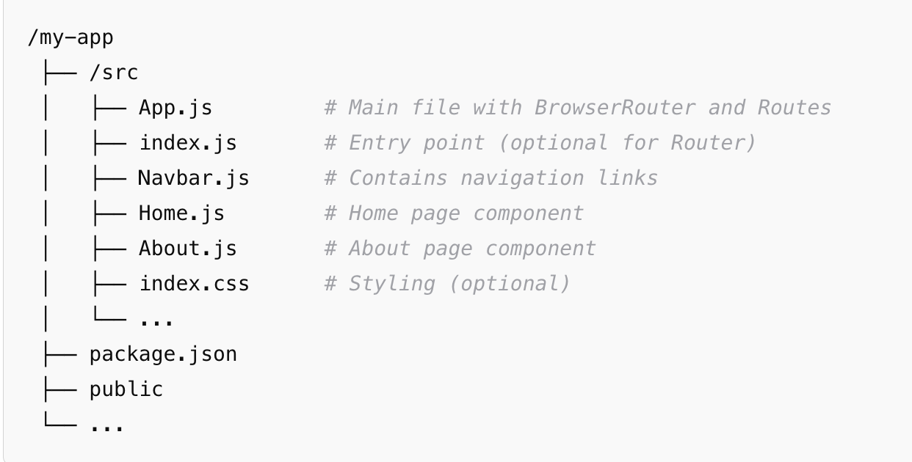
Installing REACT Routers
First, install React Router using:
npm install react-router-dom

Slide 16
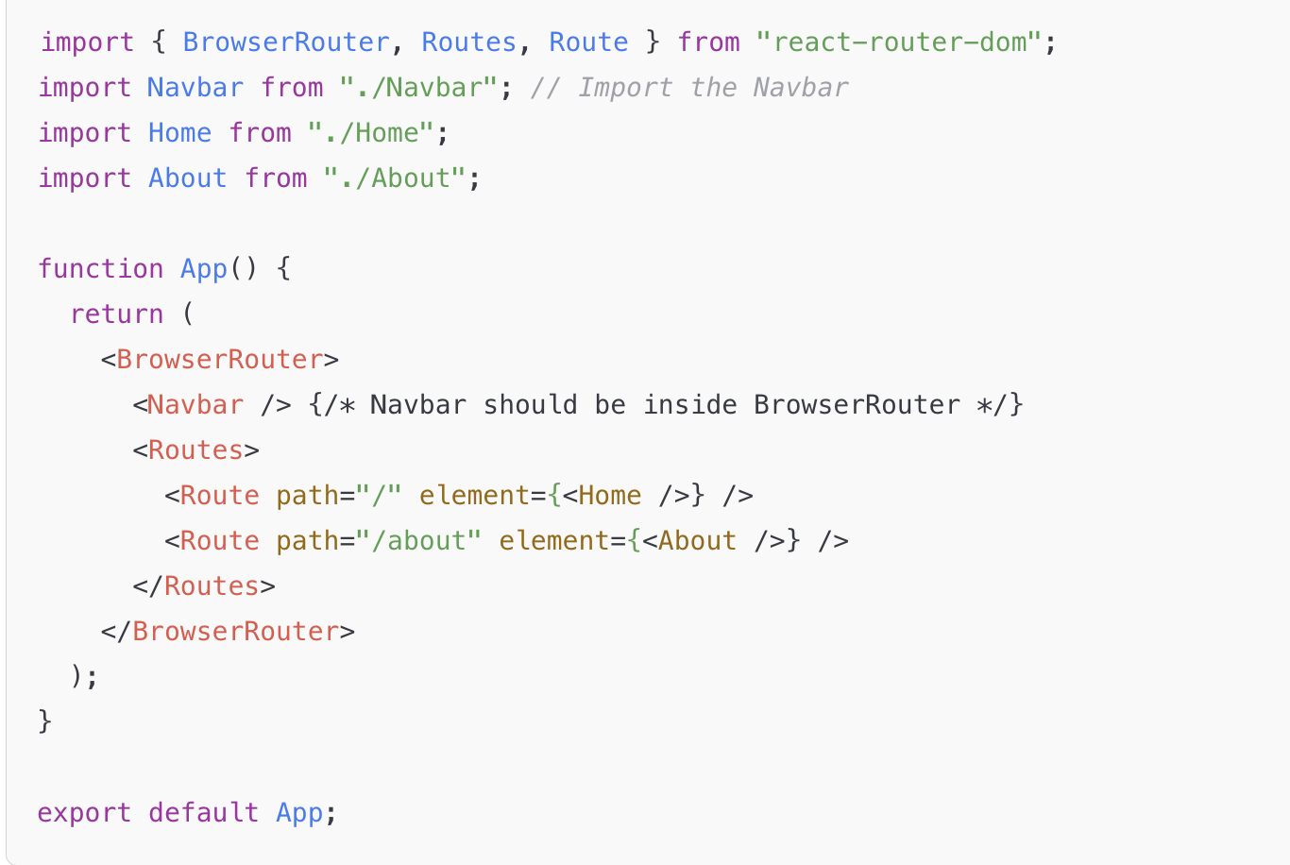
REACT Routers Use
Example: App.js

Slide 17
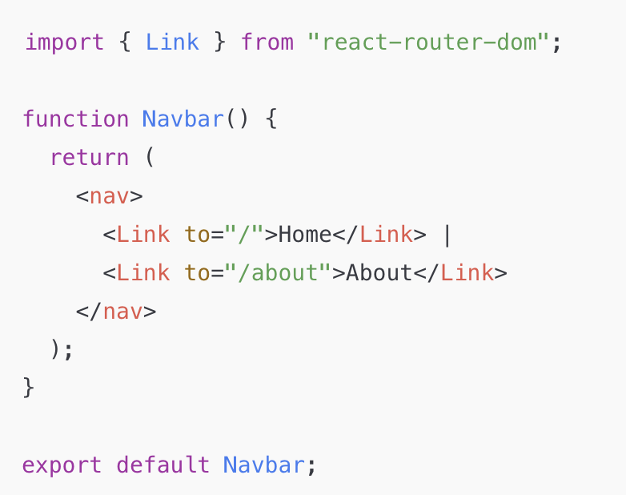
REACT Routers Use
Example: Navbar.js
This is a separate component for easy reuse.
Use <Link> instead of <a>
Problem: The page reloads every time a user clicks the link.
Solution: React Router provides <Link>, which updates the URL without a full page reload

Slide 18
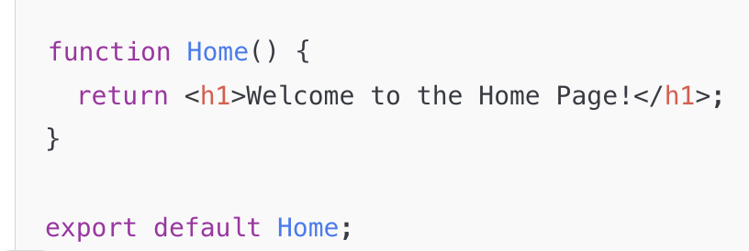
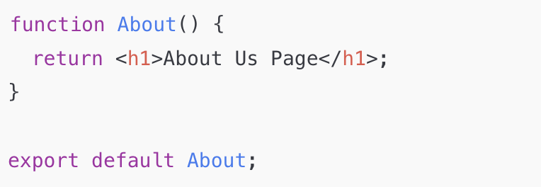
REACT Routers Use
Example: Home.js
✅ Example: About.js

Slide 19
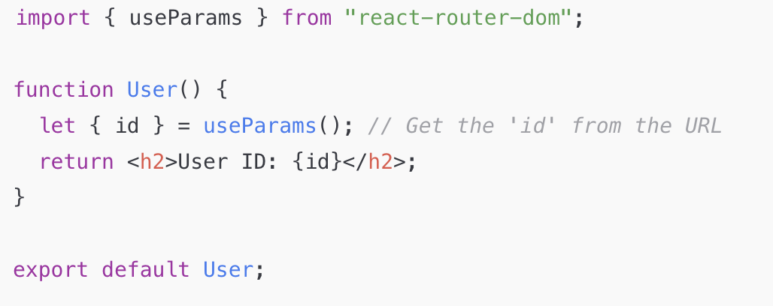
Dynamic Routes
useParams() for Dynamic Routes
The useParams() hook allows us to access route parameters from the URL.
🔹 Example: If your URL is /user/5, then 5 is the dynamic parameter (User ID).
<Route path="/user/:id" element={<User />} /> {/* Dynamic Route */}
<Link to="/user/5">Go to User 5</Link> {/* Link with Dynamic ID */}

Slide 20
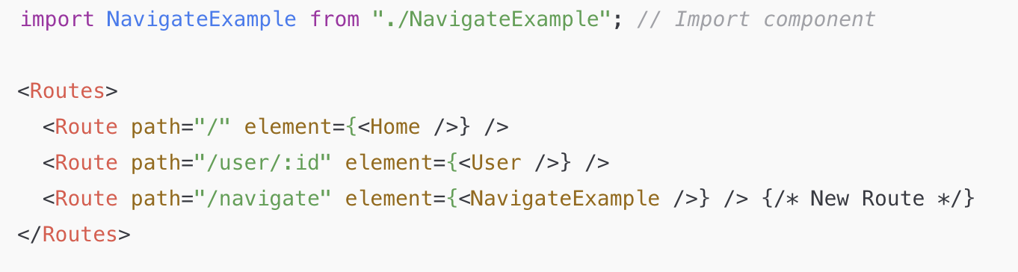
Redirect Programmatically
The useNavigate() hook is used to programmatically redirect users.
Example Use Cases
Redirect after form submission
Redirect when a condition is met
Redirect with dynamic parameters

Slide 21
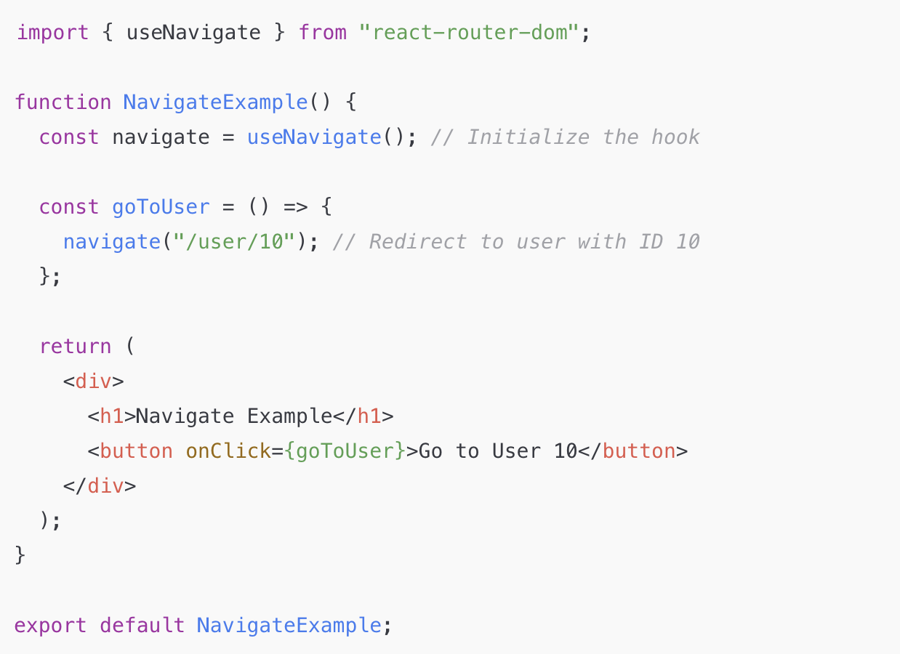
Redirect

Slide 22
Helping Material
React Official Documentation https://react.dev
The best official guide to learn React.
Covers JSX, components, state, props, hooks, and routing.
Full Modern React Course (Scrimba) https://scrimba.com/learn/learnreact
The Road to React (Free Book Sample)
🔗 https://www.roadtoreact.com
FreeCodeCamp’s Open-Source React Course
https://www.freecodecamp.org/learn/front-end-development-libraries/react/
Open-source interactive React course.
Covers functional components, class components, and Redux.

